Slide 1

Operating systems
Lecture # 07

Slide 2
Lecture Overview
CPU Scheduling Algorithms – Non-Preemptive
First-Come, First-Serve (FCFS) Scheduling

Slide 3
Key Parameters in CPU scheduling
Arrival Time (AT) | The time when a process enters the ready state (i.e., when it arrives for execution).
Burst Time (BT) | Time required by a process to complete its execution on CPU. (Time Duration not point of time)
Completion Time (CT) | The time when a process finishes its execution completely.
Turnaround Time (TAT) | The total time taken by a process from arrival to completion. (Completion Time - Arrival time)
Waiting Time (WT) | The total time a process spends waiting in the ready state (not executing). (Turnaround Time - Burst time)
Response Time (RT) | The time from when a process arrives until it gets the CPU for the first time. (First Time – Arrival time)

Slide 4
First-Come, First-Served Scheduling
CPU-scheduling algorithm is the first-come first-serve (FCFS) scheduling algorithm.
With this scheme, the process that requests the CPU first is allocated the CPU first.
The implementation of the FCFS policy is easily managed with a FIFO queue.
When a process enters the ready queue, its PCB is linked onto the tail of the queue.

Slide 5
First-Come, First-Served Scheduling
When the CPU is free, it is allocated to the process at the head of the queue.
The running process is then removed from the queue.
On the negative side, the average waiting time under the FCFS policy is often quite long.
Consider the following set of processes that arrive at time 0, with the length of the CPU burst given in milliseconds:

Slide 6
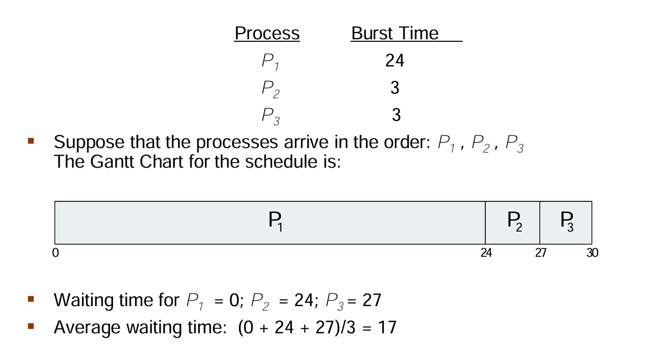
Preemptive Vs non-preemptive

Slide 7
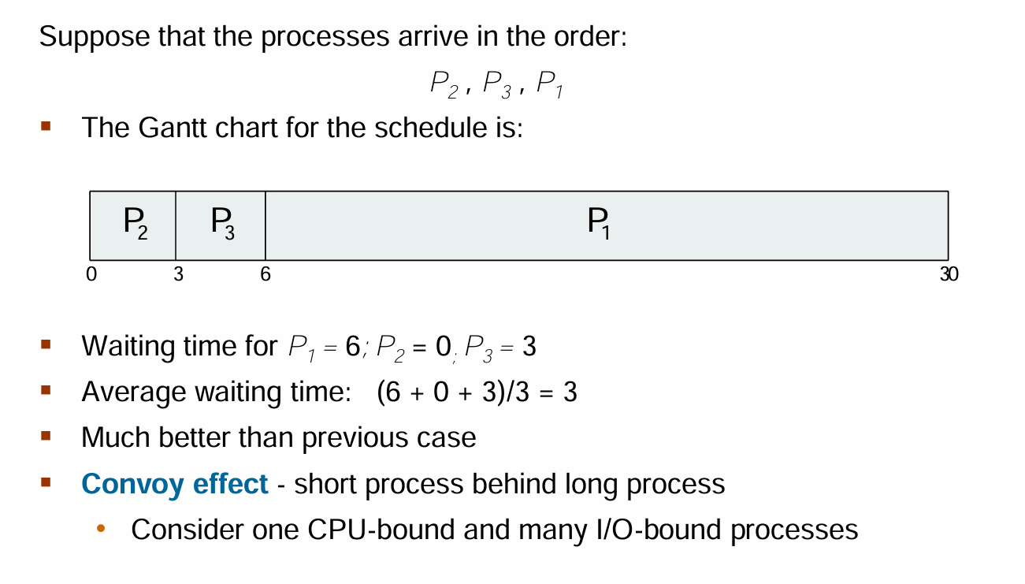

Slide 8
First-Come, First-Served Scheduling
Criteria – Arrival Time
Mode - Non-preemptive
Solved Example
Process | Arrival Time (AT) | Burst Time / Execution Time | Completion Time (CT) | Turnaround Time (TAT) | Waiting Time (WT) | Response Time (RT)
P1 | 0 | 2 | 2 | 2 | 0 | 0
P2 | 1 | 2 | 4 | 3 | 1 | 1
P3 | 5 | 3 | 8 | 3 | 0 | 0
P4 | 6 | 4 | 12 | 6 | 2 | 2
Gantt Chart
P1 | P2 | CPU IDLE | P3 | P4
0 2 4 5 8 12
Time

Slide 9
First-Come, First-Served Scheduling
Question:
Consider the following set of processes with their Arrival Time and Burst Time (in milliseconds). find:
Turnaround Time (TAT)
Waiting Time (WT)
Average Turnaround Time (AVG TAT)
Average Waiting Time (AVG WT)
Total Time of Process Execution
Process | Arrival Time (AT) | Burst Time / Execution Time
P1 | 2 | 5
P2 | 0 | 3
P3 | 4 | 5

Slide 10
Thank you!
“The kernel never sleeps”

